Slide 1
Notes

Slide 2
map()
flatmap()
One to N Transformations
Does more than just transformation. Subscribes to Flux or Mono that’s part of the transformation and then flattens it and sends it downstream
Used for asynchronous transformations
Use it with transformations that returns Publisher
One to One transformation
Does the simple transformation from T to V
Used for simple synchronous transformations
Does not support transformations that returns Publisher

Slide 3
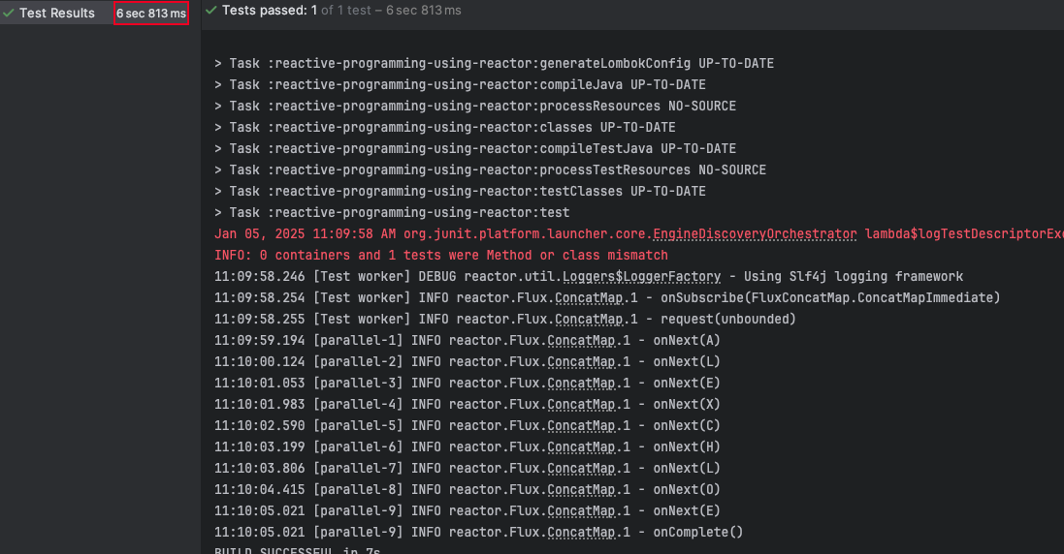
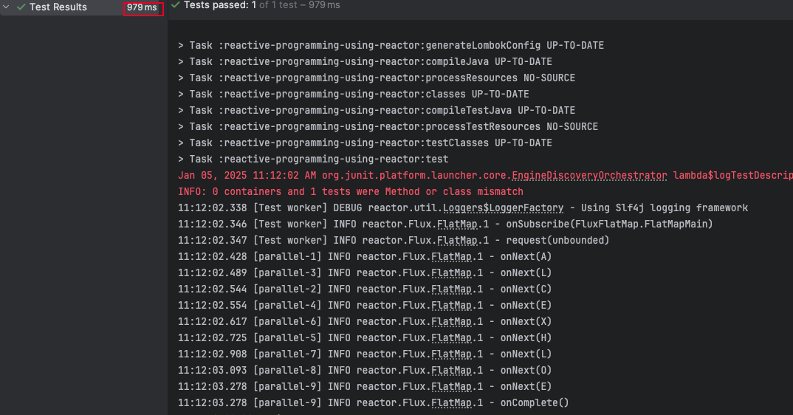
Concatmap()
flatmap()
If the sequence/ orders doesn’t matter
Faster
If the sequence/ orders matter
Slower

Slide 4
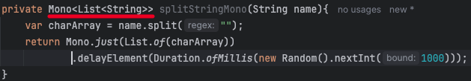
flatMap in Mono
Use it when the transformation returns a Mono
Returns a Mono<T>
Use flatMap if the transformation involves making a REST API call or any kind of functionality that can be done asynchronously.
Example

Slide 5
mergeSequential()
Used to combine two Publisher(Flux) in to one
Static method in Flux
Both the publishers are subscribed at the same time
Publisher are subscribed eagerly
Even though the publishers are subscribed eagerly the merge happens in a sequence

Slide 6
Zip() & zipWith()
zip()
Static method that’s part of the Flux
Can be merge up-to 2 to 8 Publishers (Flux or Mono) in to one
zipWith()
This is an instance method that’s part of the Flux and Mono
Used to merge two Publishers into one
Publishers are subscribed eagerly
Waits for all the Publishers involved in the transformation to emit one element
Continues until one publisher send an onComplete event

Slide 7
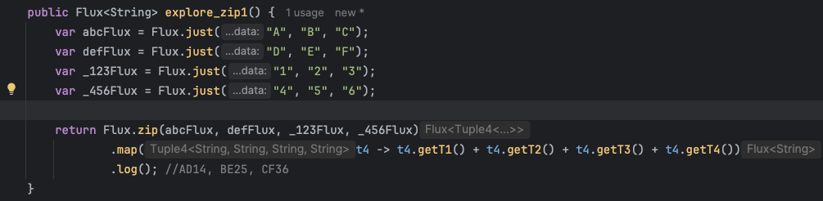
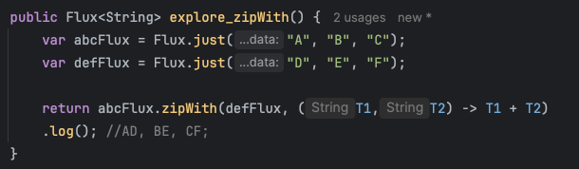
zip()
zipWith()

